Slide 1

Dependency
Injection

Slide 2
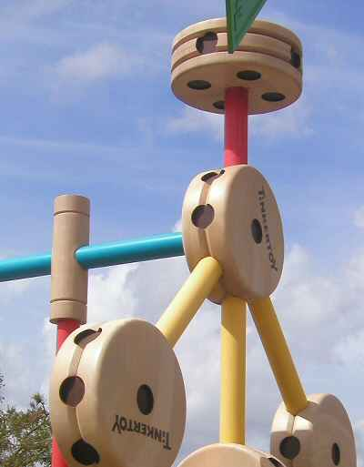
The Pursuit of the Loosely Coupled System

Slide 3


Slide 4
SOLID Princples

Slide 5
SOLID Princples
Liskov Substitution Principle
Any object in your application should be able to be replaced with a type derived from it without breaking the application

Slide 6
SOLID Princples
Dependency Inversion Principle
Code should depend on abstractions; not concrete implementations. Furthermore, the abstractions should not depend on the details; the details should depend on the abstractions

Slide 7
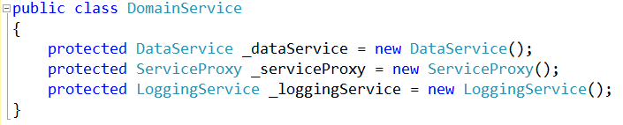
Basic Entity-Based Architecture
Database Access Service
Domain Service
Database Access Service
Service Proxy
Logging Service
Etc..
Service Proxy
Logging Service
Tightly coupled services!

Slide 8

Doesn’t promote reusability
Creates brittle systems
Difficult to “mock” makes testing difficult

Slide 9
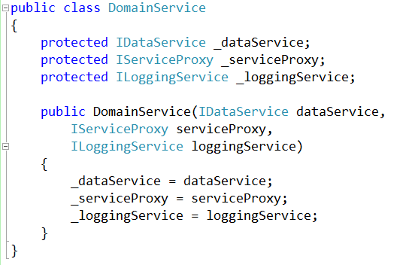
With Dependency Injection

Slide 10

Characteristics of a unit test

Slide 11
External
Resource
Code Under
Test
External
Resource
External
Resource

Slide 12
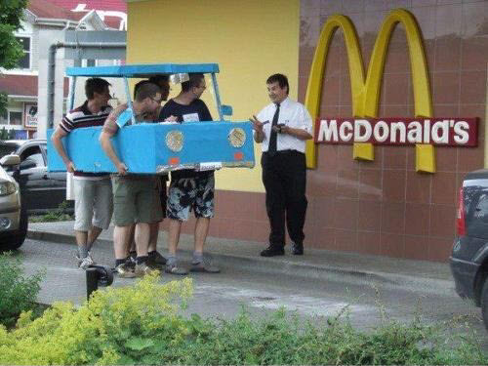
Mocking

Slide 13
External
Resource
Mock
Code Under
Test
Mock
External
Resource
Mock
External
Resource

Slide 14
Uses Actual
Business Logic
External
Resource
Mock
Code Under
Test
Mock
External
Resource
Returns canned
response
Mock
External
Resource

Slide 15
With Dependency Injection

Slide 16
The Wonderful World of Mocks
Dummies
Fakes
Stubs
Mocks
Spys
Notes:
Fake – predicatble result, not actual production logic
Stub – returns a specific result for a specific predefined input
Mock – Like a stub, but can track order and how often a method is called
Spy – Instead of creating a new object it replaces the methods the tester wants to mock (future mocking)
Dummy – a placeholder

Slide 17

Demo
Time!

Slide 18
http://bit.ly/1QvOMhC
http://bit.ly/1syIhmm
http://bit.ly/1YCrd8N

